Slide 1
Linear algebra

Slide 2
Matrices

Slide 3
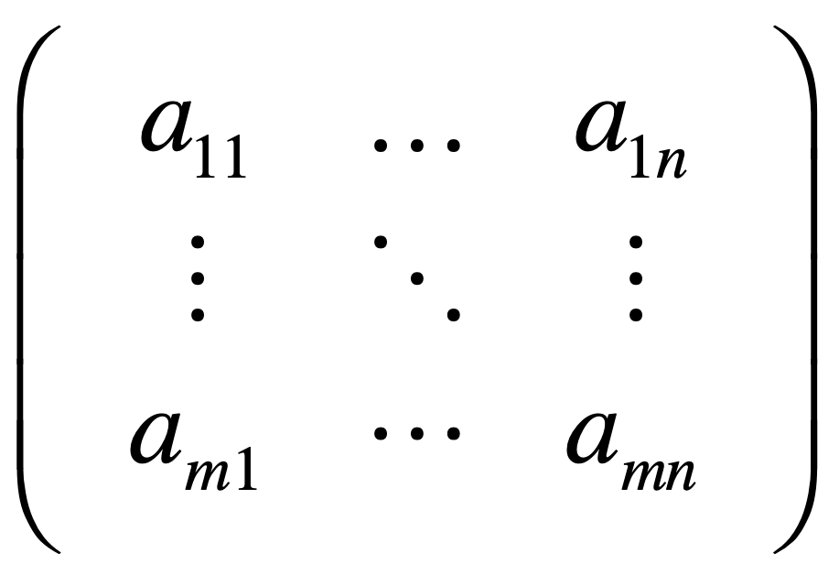

Slide 4
Vectors

Slide 5
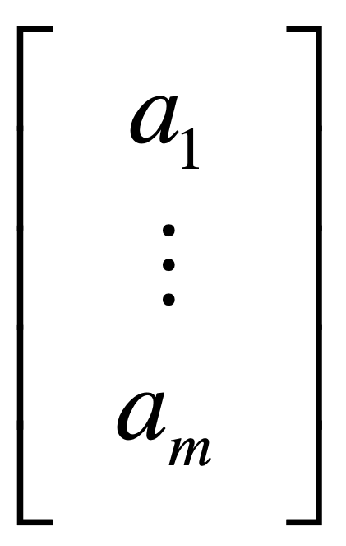

Slide 6
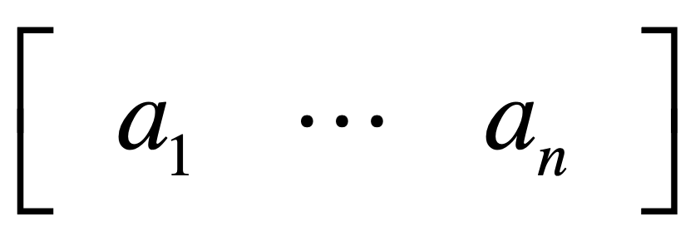

Slide 7
a sequence of numbers

Slide 8
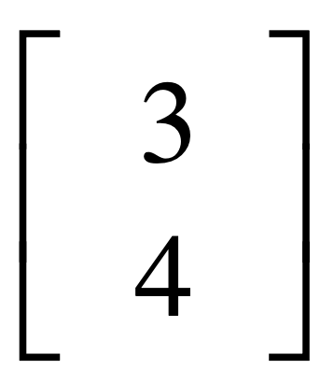
y
4
x
3

Slide 9
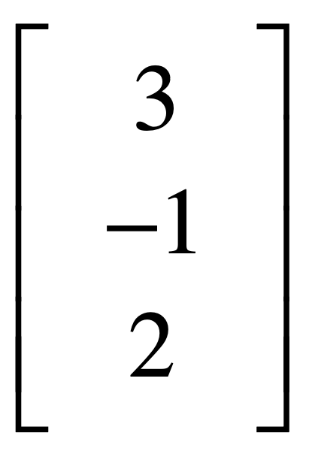
z
2
3
x
-1
y

Slide 10
vector multiplication

Slide 11
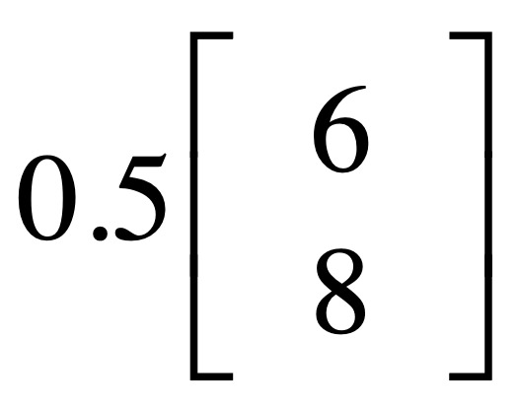
y
8
x
6

Slide 12
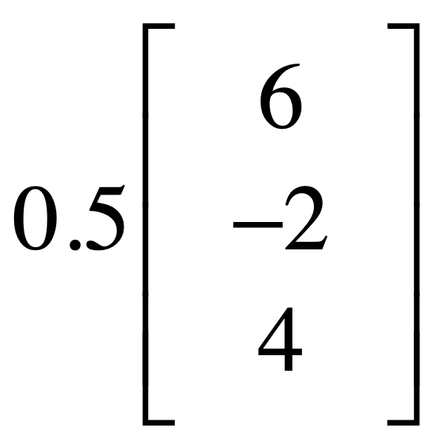
z
4
6
x
-2
y

Slide 13
vector addition

Slide 14
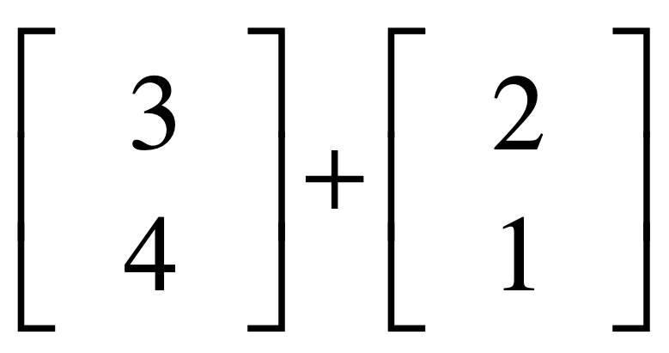
y
4
1
x
2
3

Slide 15
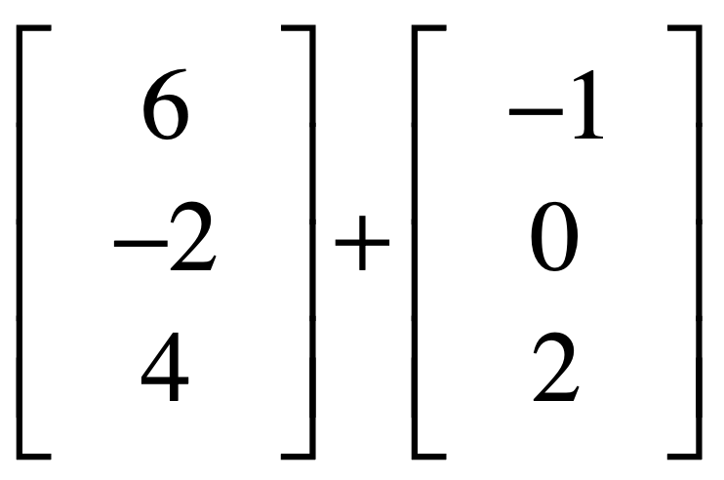
z
6
4
2
6
x
-1
-2
y

Slide 16
Vector spaces

Slide 17
Requirements
to become a vector space:
linear combinations
still stay in the space

Slide 18
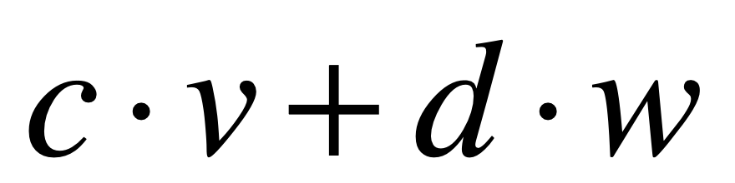
linear combinations
scalars
vectors

Slide 19

e.g., not a vector space
y
linear combinations
can’t stay here
x

Slide 20
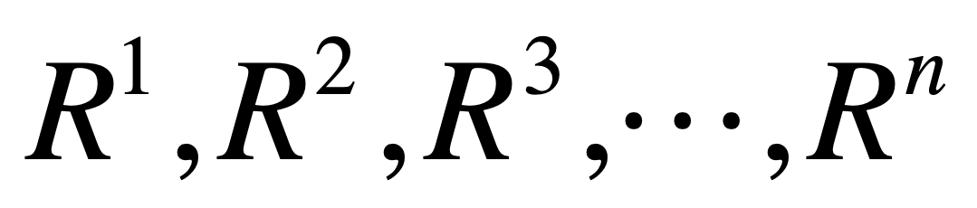

Slide 21
R^{n} space
consists of all vectors
with n components

Slide 22
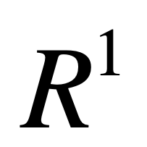
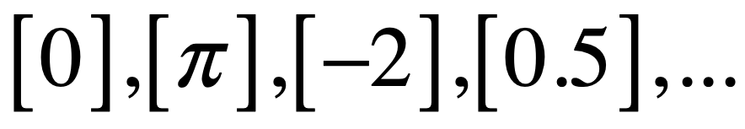
-2
0
0.5
π

Slide 23
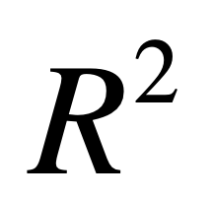
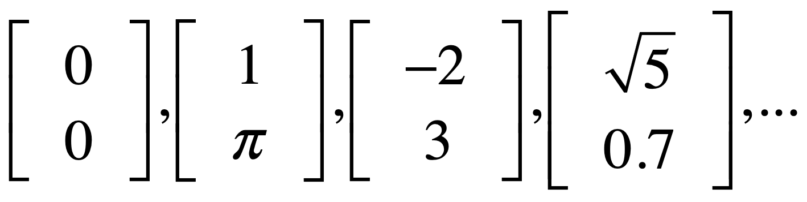
y
3
x
-2
1

Slide 24
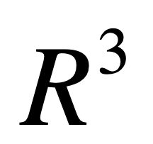
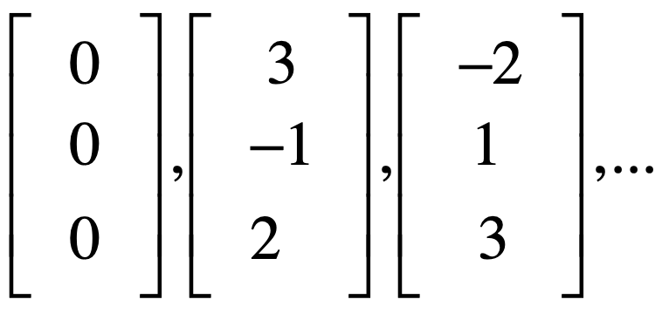
3
z
2
1
-2
3
x
-1
y

Slide 25
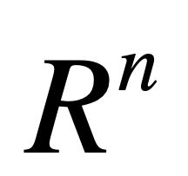
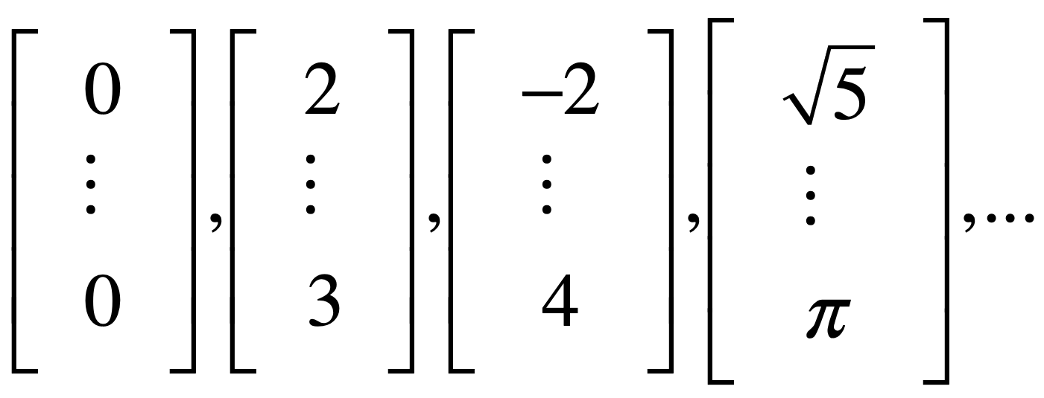

Slide 26
Column space

Slide 27
Columns of A^{mxn} in R^{m},
all their linear combinations
form a subspace(포함관계):
column space, C(A)
Notes:
원점만 있으면 0차원

Slide 28
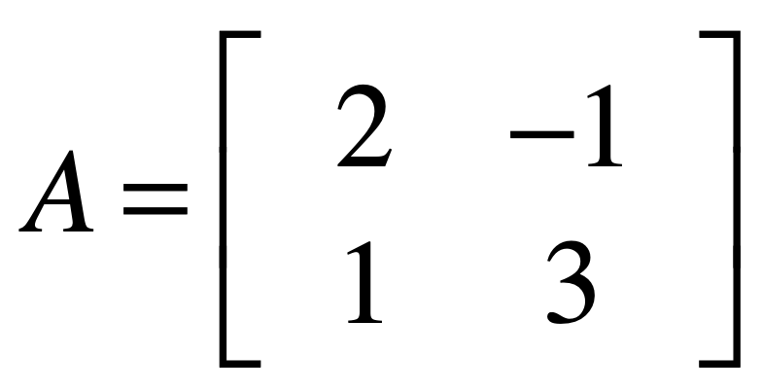

Slide 29
y
col2
3
col1
1
x
-1
2

Slide 30
col1 & 2 NOT on a line
-> independent

Slide 31
all their linear combinations?

Slide 32
y
x

Slide 33
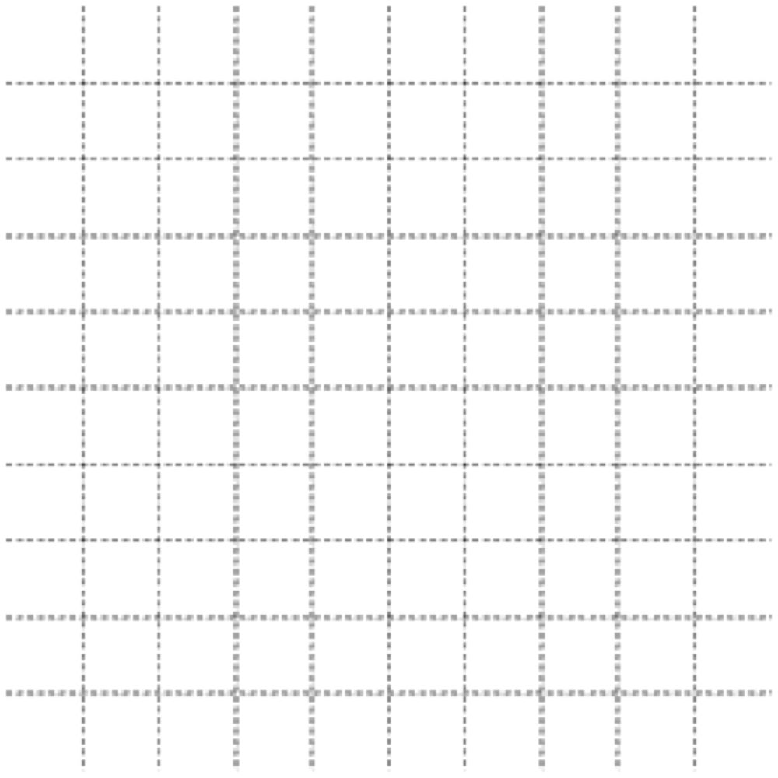
y
x
Whole space: R²
Column space: R²

Slide 34
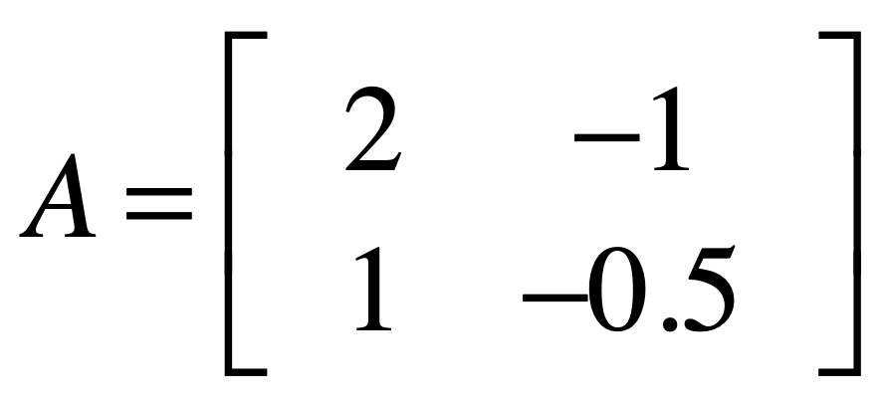

Slide 35
y
3
col1
1
x
-1
-5
2
col2

Slide 36
col1 & 2 on a line
-> dependent

Slide 37
all their linear combinations?

Slide 38
y
x
Whole space: R²
Column space: L
Notes:
Rank도 1

Slide 39
dim(whole space)
n rows
dim(column space)
n of independent columns
=rank

Slide 40
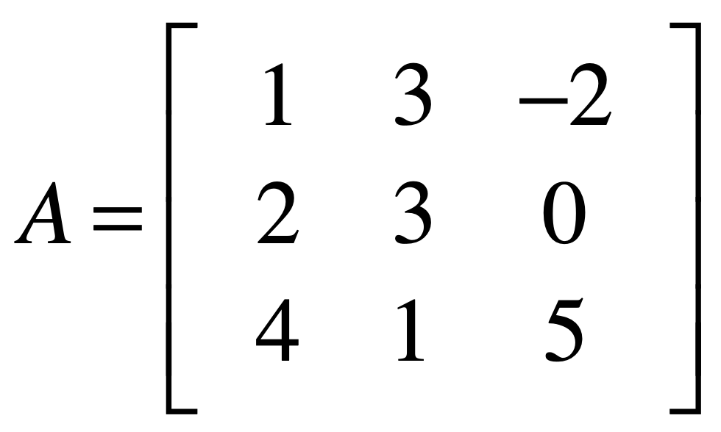
Whole space: R³
Column space: R³

Slide 41
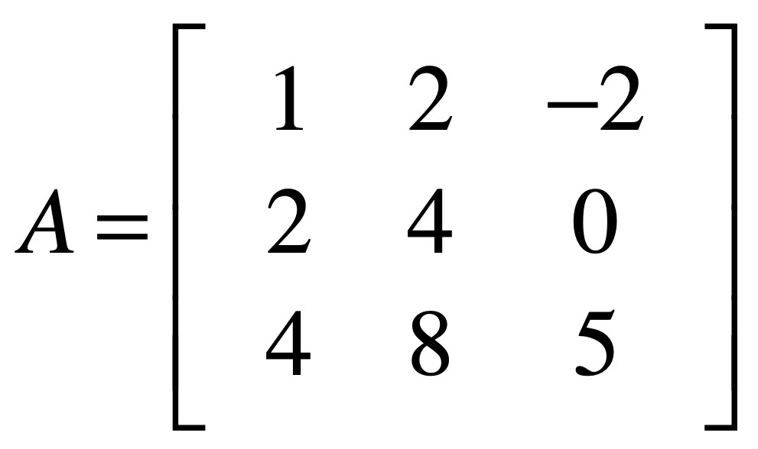
Whole space: R³
Column space: P(=plane, 2차원)

Slide 42
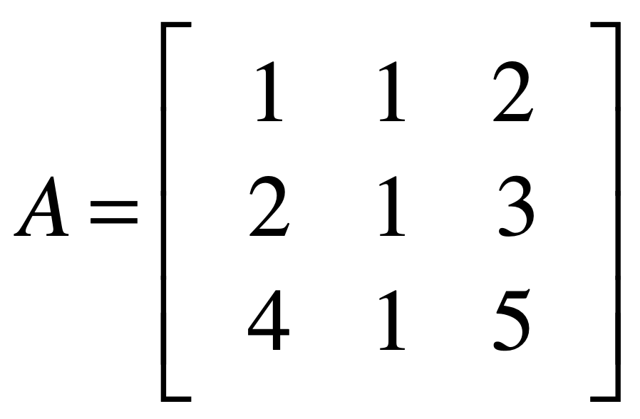
Whole space: R³
Column space: P
Notes:
첫 번째 colum과 두 번째의 합으로 2 3 5 를 만들 수 있기 때문에 두 개만 independent 하다. 따라서 2차원이 된다.

Slide 43
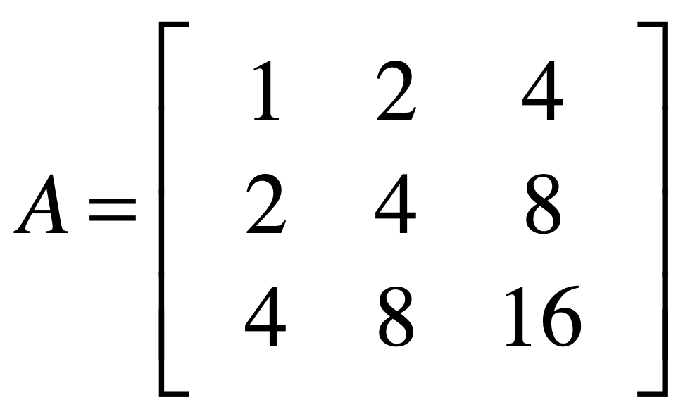
Whole space: R³
Column space: L

Slide 44
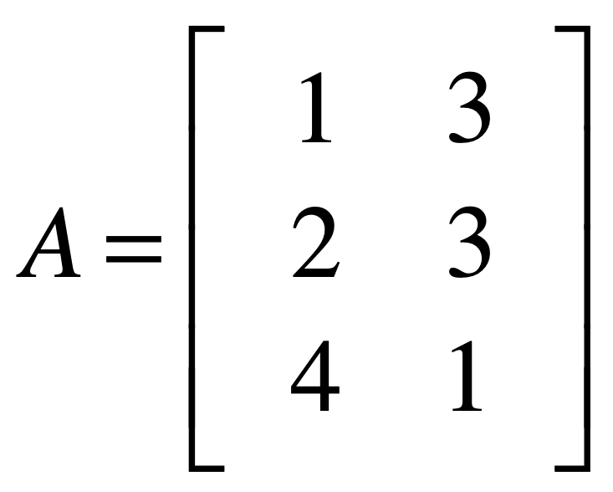
Whole space: R³
Column space: P

Slide 45
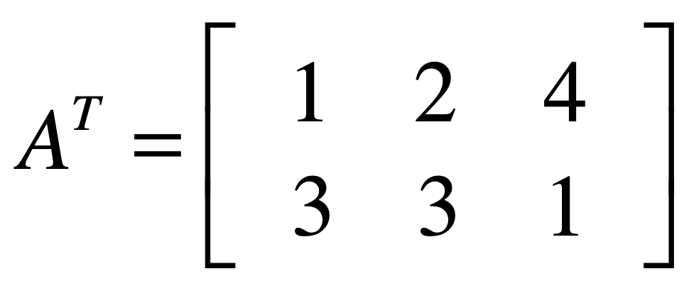
Whole space: R²
Column space: R²
Notes:
Colum space는 전치되어도 동일하다.

Slide 46
Four spaces in a matrix

Slide 47
An mxn matrix
has two whole spaces:
R^{m} and R^{n}

Slide 48
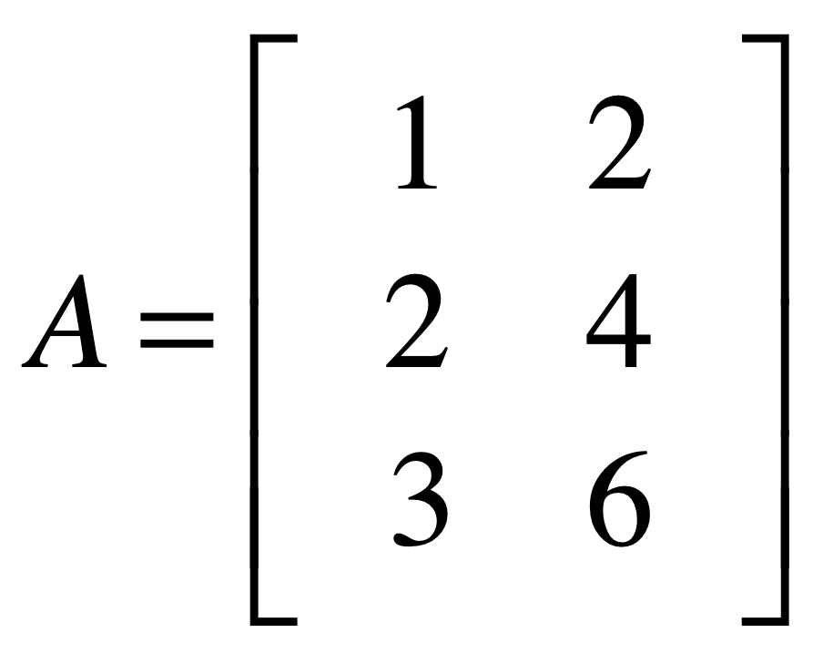

z
R³
x
whole space (column)
y
y
R²
whole space (row)
x

Slide 49

z
R³
column space
x
whole space (column)
y
y
R²
whole space (row)
row space
x
Notes:
Column space=row space=rank

Slide 50
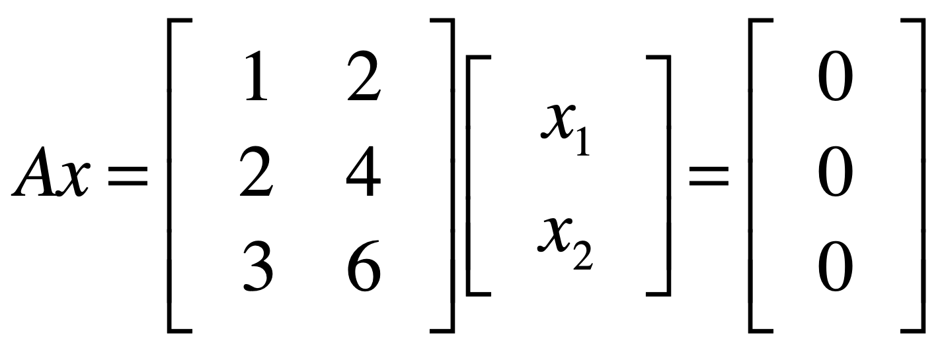
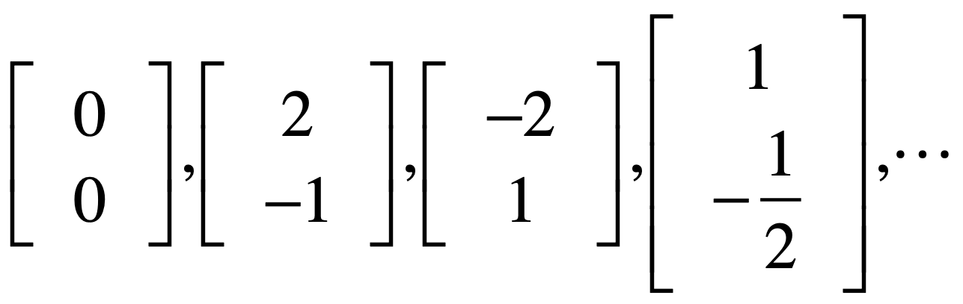
null space

Slide 51
z
R³
column space
x
whole space (column)
y
y
R²
whole space (row)
null space
row space
x

Slide 52
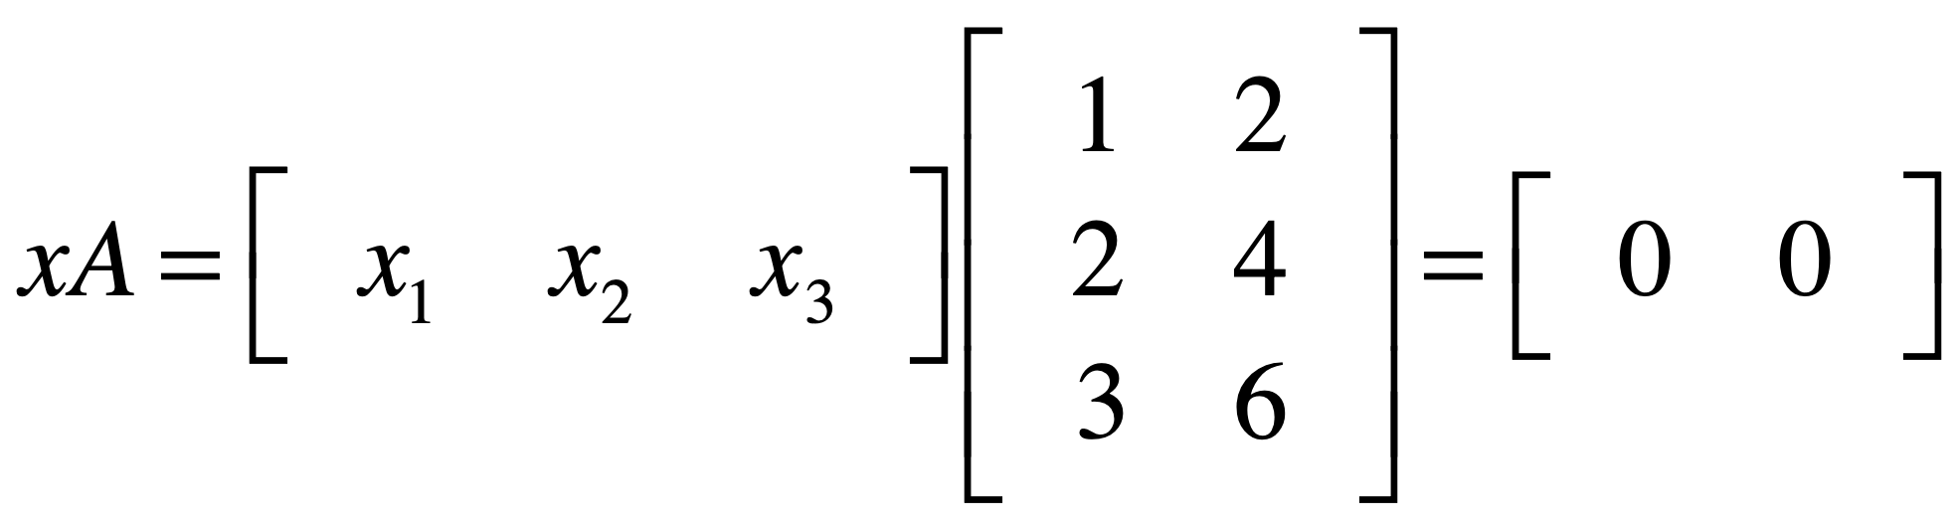
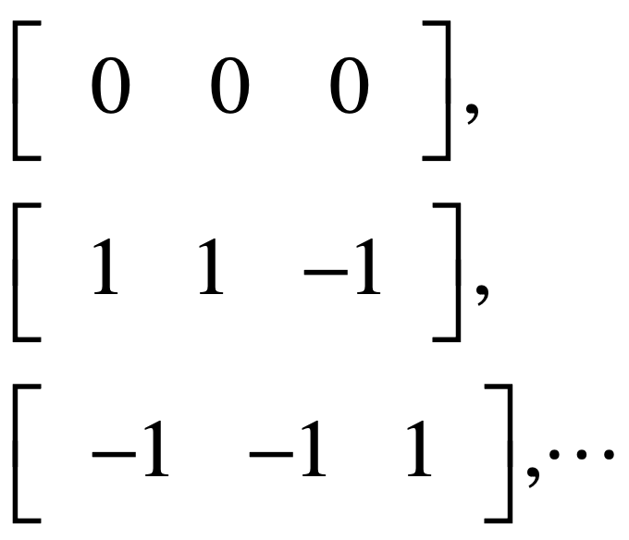
left null space

Slide 53
z
R³
column space
left null space
x
whole space (column)
y
y
R²
whole space (row)
row space
x

Slide 54
z
R³
column space
left null space
x
whole space (column)
y
y
R²
whole space (row)
null space
row space
x

Slide 55
row space
null space
r
n-r
column space
r
whole space (column)
m
left null space
m-r
n
whole space (row)

Slide 56
Linear transformation

Slide 57
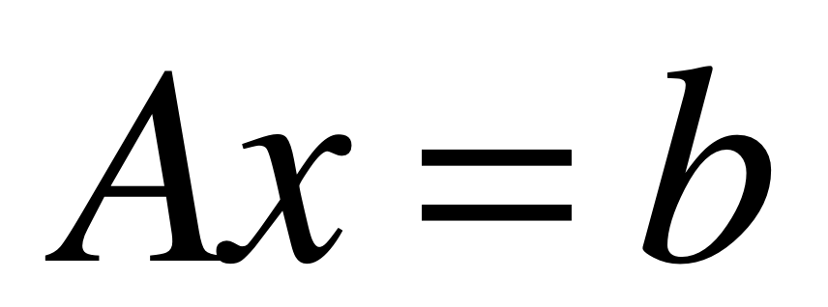

Slide 58
place x on original grid
transform x onto A grid
read transformed x
on original grid (=b)

Slide 59
example 1

Slide 60
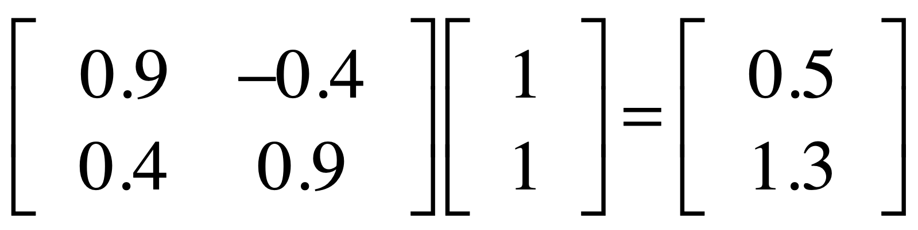

Slide 61

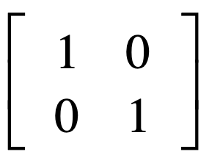
basis vector
basis vector
original grid

Slide 62

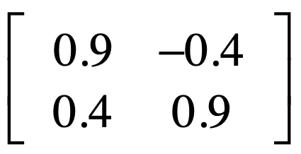
basis vector
basis vector
A (transformation) grid

Slide 63
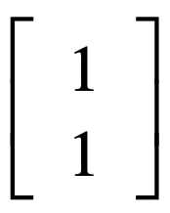

Slide 64
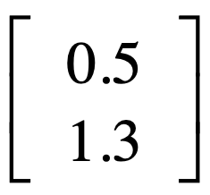

Slide 65
example 2

Slide 66
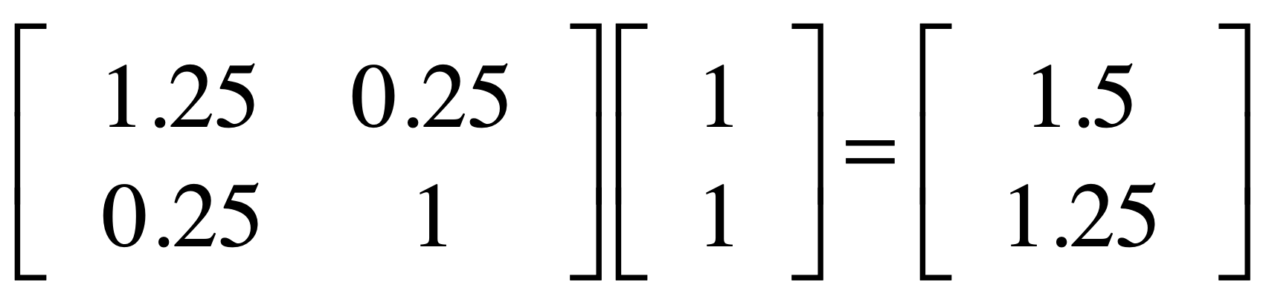

Slide 67
basis vector
basis vector
original grid

Slide 68

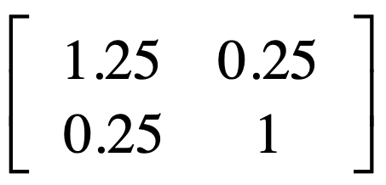
basis vector
basis vector
A (transformation) grid

Slide 70
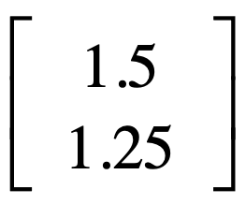

Slide 71
example 3

Slide 72
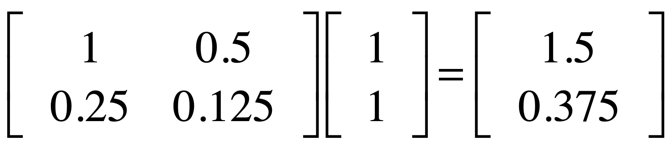

Slide 73
basis vector
basis vector
original grid

Slide 74
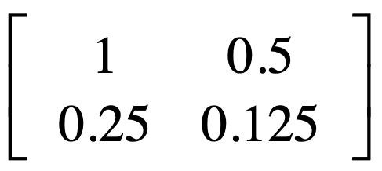
basis vectors
A (transformation) grid

Slide 76
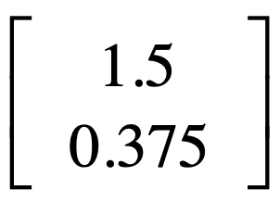

Slide 77

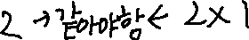
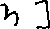


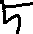
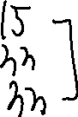

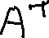














Slide 78




































Slide 79
Detransformation:
Inverse matrix

Slide 80



Slide 81
example 1

Slide 82


Slide 83
basis vector
basis vector
A (transformation) grid

Slide 84
basis vector
basis vector
original grid

Slide 87
example 2

Slide 88


Slide 89
basis vector
basis vector
A (transformation) grid

Slide 90
basis vector
basis vector
original grid

Slide 93
example 3

Slide 94


Slide 95
basis vector
basis vector
original grid

Slide 96
basis vectors
A (transformation) grid

Slide 98
?
?
?
not invertible
?
?
?
?
?
?
?

Slide 99
eigenvector

Slide 100


Av=b
A transforms v to b
x space
b space

Slide 101
Among all v,
some v is parallel to Av.
that v is eigenvector

Slide 102



Slide 103
Visualizing
eigenvectors
http://setosa.io/ev/eigenvectors-and-eigenvalues/

Slide 104


Notes:
Where should I apply this?

Slide 105

eigenspace
Notes:
원점과 입력과 출력이 평행해지는 지점. 중요한 것은 vector가 방향이라는 점. 반드시 그 선을 따라갈 필요는 없다(방향이 같다면)
Given 행렬에서 eigenvector는 무엇이냐? : 값만 존재하는 것이 아니고 방향 전체. 따라서 집합이 되면 그 선을 eigenspace라고 부른다.

Slide 106

Eigenvalues는 eigenspace가 2이기 때문에 2개이다.

Slide 107

Correlation
R : -1부터 1까지
0일 때 상관관계가 없는 것
완전히 일직선 상에 놓이게 되면 -1또는 1로 상관관계
선형대수를 사용해보면
$$\cos{α}=r$$
90도이면 r =0
0도이면 r=1
Inner product(dot product)
[1,2,3]
[4,5,6]
다 곱해서 더해주면 inner product
∴32

Slide 108




























